Slide 1

Project Github
Project Website (PWEB)
Inventory Site (Product)

Slide 2





Teammates
Michal Zajac
Brandon Bejarano
Mason Wittkofski
Jake Carney
Waleed Kambal

Slide 3
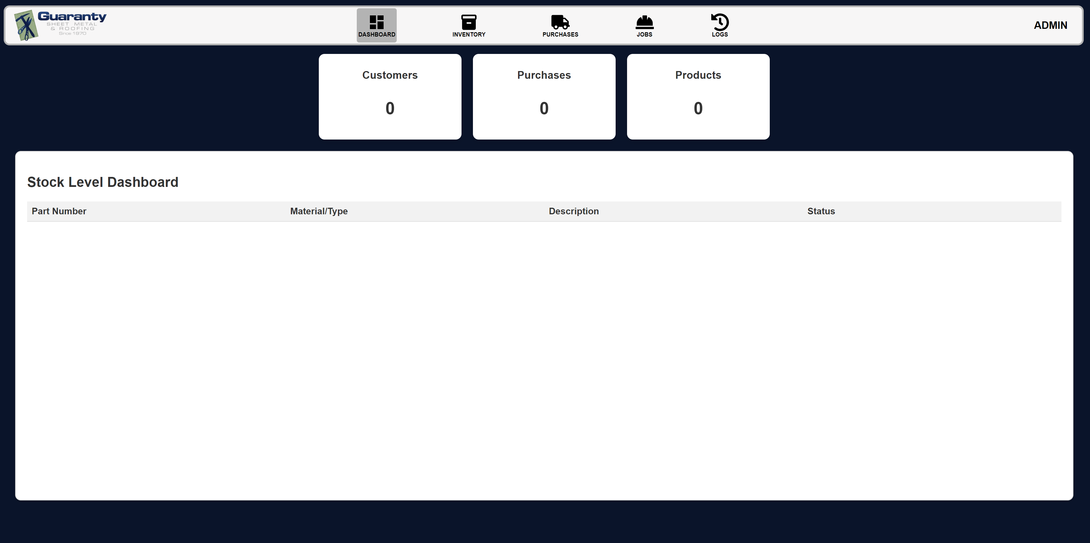
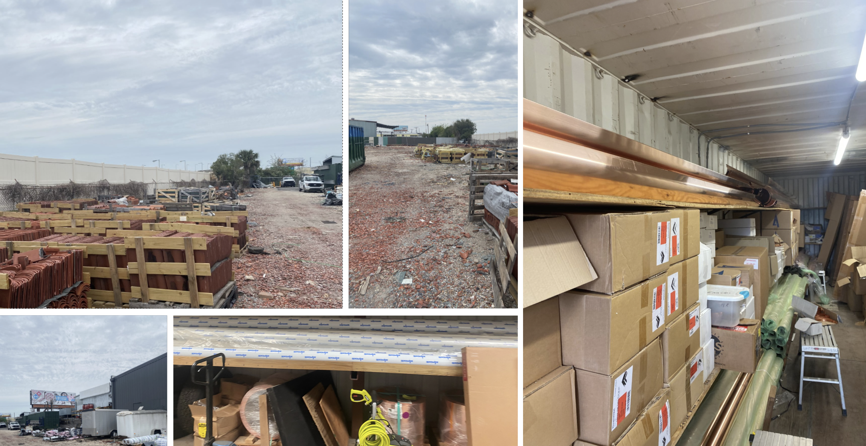
Project Focus
Our project is focused on designing an inventory management system for Guaranty Sheet Metal based in New Orleans, LA.
We're looking to build them a web application that they can use to track their current inventory, create and edit incoming and outgoing shipments for jobs, and manage supplies received.

Slide 4


High Level Functionality (1 of 2)
Dashboard
Displays "low" and "out of stock" products
Displays the number of jobs, purchases, and products
Inventory
Add, delete, edit inventory
Filter inventory using checkboxes and Search bar
Purchases
Add, delete, edit purchase orders
Search for purchase orders
Add all "low" and "out of stock" products to order
Generate an excel file for the new order that can be sent to supplier
Adjust mark-up pricing based on new inventory received

Slide 5



High Level Functionality (2 of 2)
Jobs
Add, delete, edit jobs
Upload estimate pdf that the sponsor uses
Add Necessary and Used parts for the job
Remove product from stock if its available
Logs
Implemented logging of every action in the app to be sure who changed, what changed, and when it changed, so the sponsor can manage the integrity of the data in the app
User Management
Role Based Access Control
Add/Remove a user from the application
Edit the role of a user in the app if ever needed
Edit of the user's information (profile)
Ex. Username, Password, Email
Update Web token based on changes

Slide 6
Major Sprint Achievements
Got the app hosted on an actual server without using external hosting services
Set up an automated testing workflow through GitHub that checks if tests pass, that blocks merges and pushes from being added to main branch that cause issues.
Finished Inventory, Jobs, and Purchases pages which interact with each other and show updates based on items added, edited, or removed from the database
Integrated the JSON Web Token into the management of users to match updates that occur
Implemented role-based access control (RBAC) to allow admins to view logs, manage users and add users to the application.
Implemented a simple informative Dashboard monitoring stocks, as well as quick stats about the number of products, customers, and purchases made.
Implemented logging for security reasons.
Fixed some security issues by using environment variables.

Slide 7
Brandon's Contributions
Provided moral support
Self-hosted our web application on a spare PC
Set up a DNS for the web application
Set up a production version of the Docker Compose file for the server
Setup GitHub Action to automatically run Cypress Test whenever a pull request is made to the main branch
Setup GitHub Action to automatically update server whenever merge is made to the main branch
Created documentation for the Nginx reverse proxy
Created tests for the Logs page
Reflection:
I learned to work with multiple different tools like Docker, Nginx, Node.js, React and Express to create a reverse proxy, REST API, and a web application
The hardest part was learning how to self-host our project on a server and have it pull the most up to date version of the main branch from GitHub.

Slide 8
Jake’s Contributions
Focus: Inventory Page
Developed front end for inventory page, API calls to database, and designed modals
Developed logic for filtering inventory
Implemented autofill and auto part number generation
Excel file upload
Created logging page and logic for logging.
Creating modals for other pages.
Code clean up.
Helped with little things on every page.
Administrative things to make sure we met standards for project and with sponsor.
Reflection:
Learned that we should implement a pipeline as the very beginning of the project.
The hardest part of the project was figuring out how we should host the project.

Slide 9
Waleed's Contributions
Focus: Dashboard Page
Developed an API for role-based user access specific to the Dashboard page.
Ensured that the "Manage Users" button on the Dashboard correctly retrieved and displayed user roles, and the control to remove and edit roles.
Created an API to fetch and display accurate, live data from various pages on the Dashboard.
Completed all required documentation for the Dashboard as specified in the project's Blackboard.
Organized and categorized all Markdown documents related to the Dashboard into their designated folders.
Reflection: I do not know how to read or know how to properly read merge conflicts (I broke main 4x). Learned how to thread api to the front end. Team building/collaboration, code discussions, and worked through bugs and features with a team.

Slide 10
Mason's Contributions
Focus: Purchases Page
Developed Complete Front-End Interface
Wrote multiple REST Api's to update orders, and their respective items and quantities.
Added status tracking to orders to trigger necessary actions.
Created End to End testing for the purchases page and its functions
Made documentation for all features I impacted
Reflection: I learned a lot during this project. How to work on a full stack software team. Also how to expose myself to new tools and languages. The hardest part for me was being able to wrap everything together into one system.

Slide 11
Michal's Contributions
Focus: Jobs Page
Created database tables
Developed a Frontend for Adding, Editing, Removing Jobs
Uploading and managing Estimate PDF w/ 5mb limit
Included Necessary Parts + Used Parts sections
Developed 25+ API endpoints
Created E2E testing for Jobs page using Cypress
Created documentation
Reflection: I exposed myself to new technologies and learned valuable skills in full-stack development. I had a great experience building a real product and collaborating in a team.

Slide 12
Significant Items on Backlog
Completed
Role based access control
Implementing the pipeline
Getting it hosted on self-hosted server with a dns
Implementing API
Getting all of the pages to work together
User Authentication and Web token usage to verify
Not-Completed
PDF scrapers for estimates and invoices.
Upload of invoice pdf
Access Guaranty Sheet Metal server in Louisiana
Email verification

Slide 13
Demo

